Slide 1
Sequential digital circuit

Slide 2
Lecture 35 Introduction to Sequential digital circuit
Lecture delivered by:
Deepak V.

Slide 3
Objectives
At the end of this lecture, student will be able to:
Acquire the knowledge of Sequential circuits
Identify the differences between Sequential circuits and Combinational circuits
Understand the working principle of basic Sequential circuits
Define Moore and mealy machines

Slide 4
Topics
Introduction to Sequential circuits
Moore machine
Mealy machine

Slide 5
Introduction to Sequential digital circuit
A Sequential circuit consists of a Combinational circuit to which storage elements are connected to form a feedback path
The storage elements are devices capable of storing binary information
The Sequential circuit receives binary information from external inputs that, together with the present state of the storage elements, determine the binary value of the outputs
The block diagram demonstrates that the outputs in a Sequential circuit are a function not only of the inputs, but also of the present state of the storage elements

Slide 6
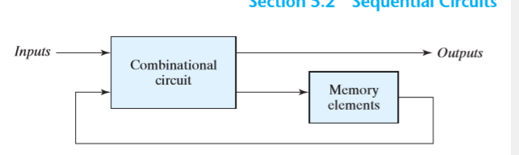
Introduction to Sequential digital circuit
A Sequential circuit is specified by a time sequence of inputs, outputs, and internal states
In contrast, the outputs of Combinational logic depend only on the present values of the input
Block diagram of Sequential circuit

Slide 7
Introduction to Sequential digital circuit
There are two main types of Sequential circuits, and their classification is a function of the timing of their signals
A synchronous Sequential circuit is a system whose behavior can be defined from the knowledge of its signals at discrete instants of time
The behavior of an asynchronous Sequential circuit depends upon the input signals at any instant of time and the order in which the inputs change

Slide 8
Introduction to Sequential digital circuit
Asynchronous
Synchronous
Combinational
Circuit
Inputs
Outputs
Memory Elements
Combinational
Circuit
Inputs
Outputs
Flip-flops
Clock

Slide 9
Moore & Mealy Machines
Finite automata may have outputs corresponding to each transition There are two types of finite state machines that generate output
Mealy Machine
Moore Machine
Mealy Machine: Output is function of present state and present input
Moore Machine: Output is function of present state only

Slide 10
Moore & Mealy Machines
Mealy Machines
A Mealy Machine is an FSM whose output depends on the present state as well as the present input
It can be described by a 6 tuple (Q, ∑, O, δ, X, q₀) where −
Q is a finite set of states
∑ is a finite set of symbols called the input alphabet
O is a finite set of symbols called the output alphabet
δ is the input transition function where δ: Q × ∑ → Q
X is the output transition function where X: Q → O
q₀ is the initial state from where any input is processed (q₀ ∈ Q)

Slide 11
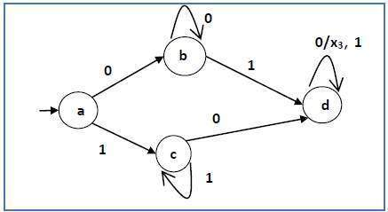
Moore & Mealy Machines
Mealy Machines
The state diagram of a Mealy Machine is shown below −
state diagram of a Mealy Machine

Slide 12
Moore & Mealy Machines
Moore Machine
Moore machine is an FSM whose outputs depend on only the present state
A Moore machine can be described by a 6 tuple (Q, ∑, O, δ, X, q₀) where
Q is a finite set of states
∑ is a finite set of symbols called the input alphabet
O is a finite set of symbols called the output alphabet
δ is the input transition function where δ: Q × Σ → Q
X is the output transition function where X: Q × Σ → O
q₀ is the initial state from where any input is processed (q₀ ∈ Q)

Slide 13
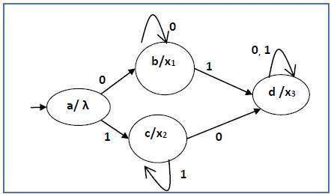
Moore & Mealy Machines
Moore Machine
The state diagram of a Moore Machine is shown below −
state diagram of a Moore Machine

Slide 14
Moore & Mealy Machines
Mealy Machine vs Moore Machine
The following table highlights the points that differentiate a Mealy Machine from a Moore Machine
Mealy Machine | Moore Machine
Output depends both upon present state and present input | Output depends only upon the present state
Generally, it has fewer states than Moore Machine | Generally, it has more states than Mealy Machine
Output changes at the clock edges | Input change can cause change in output change as soon as logic is done
Mealy machines react faster to inputs | In Moore machines, more logic is needed to decode the outputs since it has more circuit delays

Slide 15
Moore & Mealy Machines
Moore Machine to Mealy Machine
Input: | Moore Machine
Output: | Mealy Machine
Step 1 | Take a blank Mealy Machine transition table format
Step 2 | Copy all the Moore Machine transition states into this table format
Step 3 | Check the present states and their corresponding outputs in the Moore Machine state table; if for a state Q_{i} output is m, copy it into the output columns of the Mealy Machine state table wherever Q_{i} appears in the next state

Slide 16
Moore & Mealy Machines
Example
Let us consider the following Moore machine −
Present State | Next State |  | Output
 | a=0 | a=1
→a | d | b | 1
b | a | d | 0
c | c | c | 0
d | b | a | 1
Moore machine

Slide 17
Moore & Mealy Machines
Moore Machine to Mealy Machine
Now we apply Algorithm 4 to convert it to Mealy Machine
Step 1 & 2
Present State | Next State
 | a=0 |  | a=1
 | State | Output | State | Output
→a | d |  | b
B | a |  | d
c | c |  | c
d | b |  | a

Slide 18
Moore & Mealy Machines
Moore Machine to Mealy Machine
Step 3
Present State | Next State
 | a=0 |  | a=1
 | State | Output | State | Output
⇒a | d | 1 | b | 0
b | a | 1 | d | 1
c | c | 0 | c | 0
d | b | 0 | a | 1

Slide 19
Moore & Mealy Machines
Mealy Machine to Moore Machine
Input: | Mealy Machine
Output: | Moore Machine
Step 1 | Calculate the number of different outputs for each state (Q_{i}) that are available in the state table of the Mealy machine
Step 2 | If all the outputs of Q_{i} are same, copy state Q_{i} If it has n distinct outputs, break Q_{i} into n states as Q_{in} where n = 0, 1, 2
Step 3 | If the output of the initial state is 1, insert a new initial state at the beginning which gives 0 output

Slide 20
Moore & Mealy Machines
Example
Let us consider the following Mealy Machine −
Present State | Next State
 | a=0 |  | a=1
 | Next State | Output | Next State | Output
→a | d | 0 | b | 1
b | a | 1 | d | 0
c | c | 1 | c | 0
d | b | 0 | a | 1
Here, states ‘a’ and ‘d’ give only 1 and 0 outputs respectively, so we retain states ‘a’ and ‘d’ But states ‘b’ and ‘c’ produce different outputs (1 and 0) So, we divide b into b0, b1 and c into c0, c1

Slide 21
Moore & Mealy Machines
Mealy Machine to Moore Machine
Present State | Next State |  | Output
 | a=0 | a=1
→a | d | b₁ | 1
b₀ | a | d | 0
b₁ | a | d | 1
c₀ | c₁ | C₀ | 0
c₁ | c₁ | C₀ | 1
d | b₀ | a | 0

Slide 22
Summary
A Sequential circuit consists of a Combinational circuit to which storage elements are connected to form a feedback path
A Sequential circuit is specified by a time sequence of inputs, outputs, and internal states
A Mealy Machine is an FSM whose output depends on the present state as well as the present input
Moore machine is an FSM whose outputs depend on only the present state

